Slide 1
Chapter 6
Concurrency: Deadlock and Starvation
Operating Systems:
Internals and Design Principles
Notes:
“Operating Systems: Internal and Design Principles”, 7/e, by William Stallings, Chapter 6 “Concurrency: Deadlock and Starvation”.

Slide 2
Operating Systems:
Internals and Design Principles
When two trains approach each other at a crossing, both shall come to a full stop and neither shall start up again until the other has gone. Statute passed by the Kansas State Legislature, early in the 20th century.
—A TREASURY OF RAILROAD FOLKLORE,
B. A. Botkin and Alvin F. Harlow
Notes:
This chapter continues our survey of concurrency by looking at two problems that plague all efforts to support concurrent processing: deadlock and starvation. We begin with a discussion of the underlying principles of deadlock and the related problem of starvation. Then we examine the three common approaches to dealing with deadlock: prevention, detection, and avoidance. We then look at one of the classic problems used to illustrate both synchronization and deadlock issues: the dining philosophers problem.
As with Chapter 5 , the discussion in this chapter is limited to a consideration of concurrency and deadlock on a single system. Measures to deal with distributed deadlock problems are assessed in Chapter 18 .

Slide 3

Deadlock
The permanent blocking of a set of processes that either compete for system resources or communicate with each other
A set of processes is deadlocked when each process in the set is blocked awaiting an event that can only be triggered by another blocked process in the set
Permanent
No efficient solution
Notes:
Deadlock can be defined as the permanent blocking of a set of processes that either compete for system resources or communicate with each other. A set of processes is deadlocked when each process in the set is blocked awaiting an event (typically the freeing up of some requested resource) that can only be triggered by another blocked process in the set. Deadlock is permanent because none of the events is ever triggered. Unlike other problems in concurrent process management, there is no efficient solution in the general case.

Slide 4

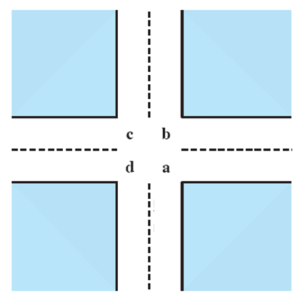
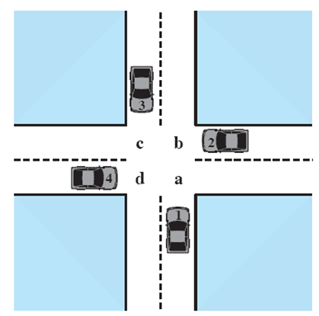



Potential Deadlock
I need quad C and D
I need quad B and C
I need quad A and B
I need quad D and A
Notes:
Animated Slide
Click 1 Cars approach intersection
Then Cars announce their resource needs
All deadlocks involve conflicting needs for resources by two or more processes. A common example is the traffic deadlock. Figure 6.1a shows a situation in which four cars have arrived at a four-way stop intersection at approximately the same time. The four quadrants of the intersection are the resources over which control is needed. In particular, if all four cars wish to go straight through the intersection, the resource requirements are as follows:
• Car 1, traveling north, needs quadrants a and b.
• Car 2 needs quadrants b and c.
• Car 3 needs quadrants c and d.
• Car 4 needs quadrants d and a.
The typical rule of the road in the United States is that a car at a four-way stop should defer to a car immediately to its right. This rule works if there are only two or three cars at the intersection. For example, if only the northbound and westbound cars arrive at the intersection, the northbound car will wait and the westbound car proceeds. However, if all four cars arrive at about the same time, each will refrain from entering the intersection, this causes a potential deadlock. The deadlock is only potential, not actual, because the necessary resources are available for any of the cars to proceed. If one car eventually does proceed, it can do so.

Slide 5
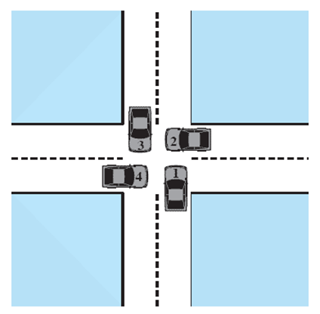
Actual Deadlock
HALT until D is free
HALT until C is free
HALT until B is free
HALT until A is free
Notes:
Animated Slide
Click 1 Cars move to deadlock
Then Cars announce their resource need
However, if all four cars ignore the rules and proceed (cautiously) into the intersection at the same time, then each car seizes one resource (one quadrant) but cannot proceed because the required second resource has already been seized by another car. This is an actual deadlock.

Slide 6
Resource Categories
Reusable
can be safely used by only one process at a time and is not depleted by that use
processors, I/O channels, main and secondary memory, devices, and data structures such as files, databases, and semaphores
Consumable
one that can be created (produced) and destroyed (consumed)
interrupts, signals, messages, and information
in I/O buffers
Notes:
Two general categories of resources can be distinguished: reusable and consumable. A reusable resource is one that can be safely used by only one process at a time and is not depleted by that use. Processes obtain resource units that they later release for reuse by other processes. Examples of reusable resources include processors; I/O channels; main and secondary memory; devices; and data structures such as files, databases, and semaphores.
A consumable resource is one that can be created (produced) and destroyed (consumed). Examples of consumable resources are interrupts, signals, messages, and information in I/O buffers.

Slide 7
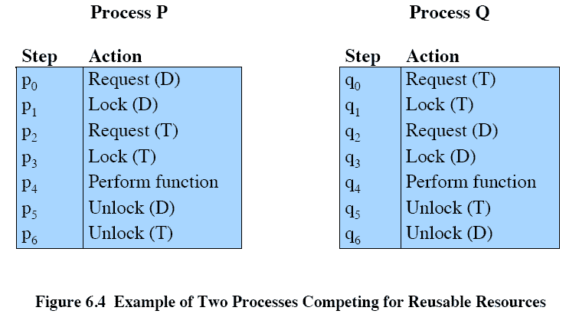
Reusable Resources
Example
Notes:
As an example of deadlock involving reusable resources, consider two processes that compete for exclusive access to a disk file D and a tape drive T. The programs engage in the operations depicted in Figure 6.4 . Deadlock occurs if each process holds one resource and requests the other. For example, deadlock occurs if the multiprogramming system interleaves the execution of the two processes as follows:
p 0 p 1 q 0 q 1 p 2 q 2
It may appear that this is a programming error rather than a problem for the OS designer. However, we have seen that concurrent program design is challenging. Such deadlocks do occur, and the cause is often embedded in complex program logic, making detection difficult. One strategy for dealing with such a deadlock is to impose system design constraints concerning the order in which resources can be requested.

Slide 8
Example 2:
Memory Request
Space is available for allocation of 200Kbytes, and the following sequence of events occur:
Deadlock occurs if both processes progress to their second request
P1
P2
. . .
. . .
Request 80 Kbytes;
Request 70 Kbytes;
. . .
. . .
Request 60 Kbytes;
Request 80 Kbytes;
Notes:
Another example of deadlock with a reusable resource has to do with requests for main memory. Suppose the space available for allocation is 200 Kbytes, and the following sequence of requests occurs: (see diagram)
Deadlock occurs if both processes progress to their second request. If the amount of memory to be requested is not known ahead of time, it is difficult to deal with this type of deadlock by means of system design constraints. The best way to deal with this particular problem is, in effect, to eliminate the possibility by using virtual memory, which is discussed in Chapter 8 .

Slide 9
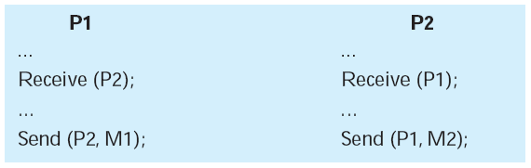
Consumable Resources Deadlock
Consider a pair of processes, in which each process attempts to receive a message from the other process and then send a message to the other process:
Deadlock occurs if the Receive is blocking
Notes:
As an example of deadlock involving consumable resources, consider the following pair of processes, in which each process attempts to receive a message
from the other process and then send a message to the other process: (see diagram)
Deadlock occurs if the Receive is blocking (i.e., the receiving process is blocked until the message is received). Once again, a design error is the cause of the deadlock. Such errors may be quite subtle and difficult to detect. Furthermore, it may take a rare combination of events to cause the deadlock; thus a program could be in use for a considerable period of time, even years, before the deadlock actually occurs.

Slide 10
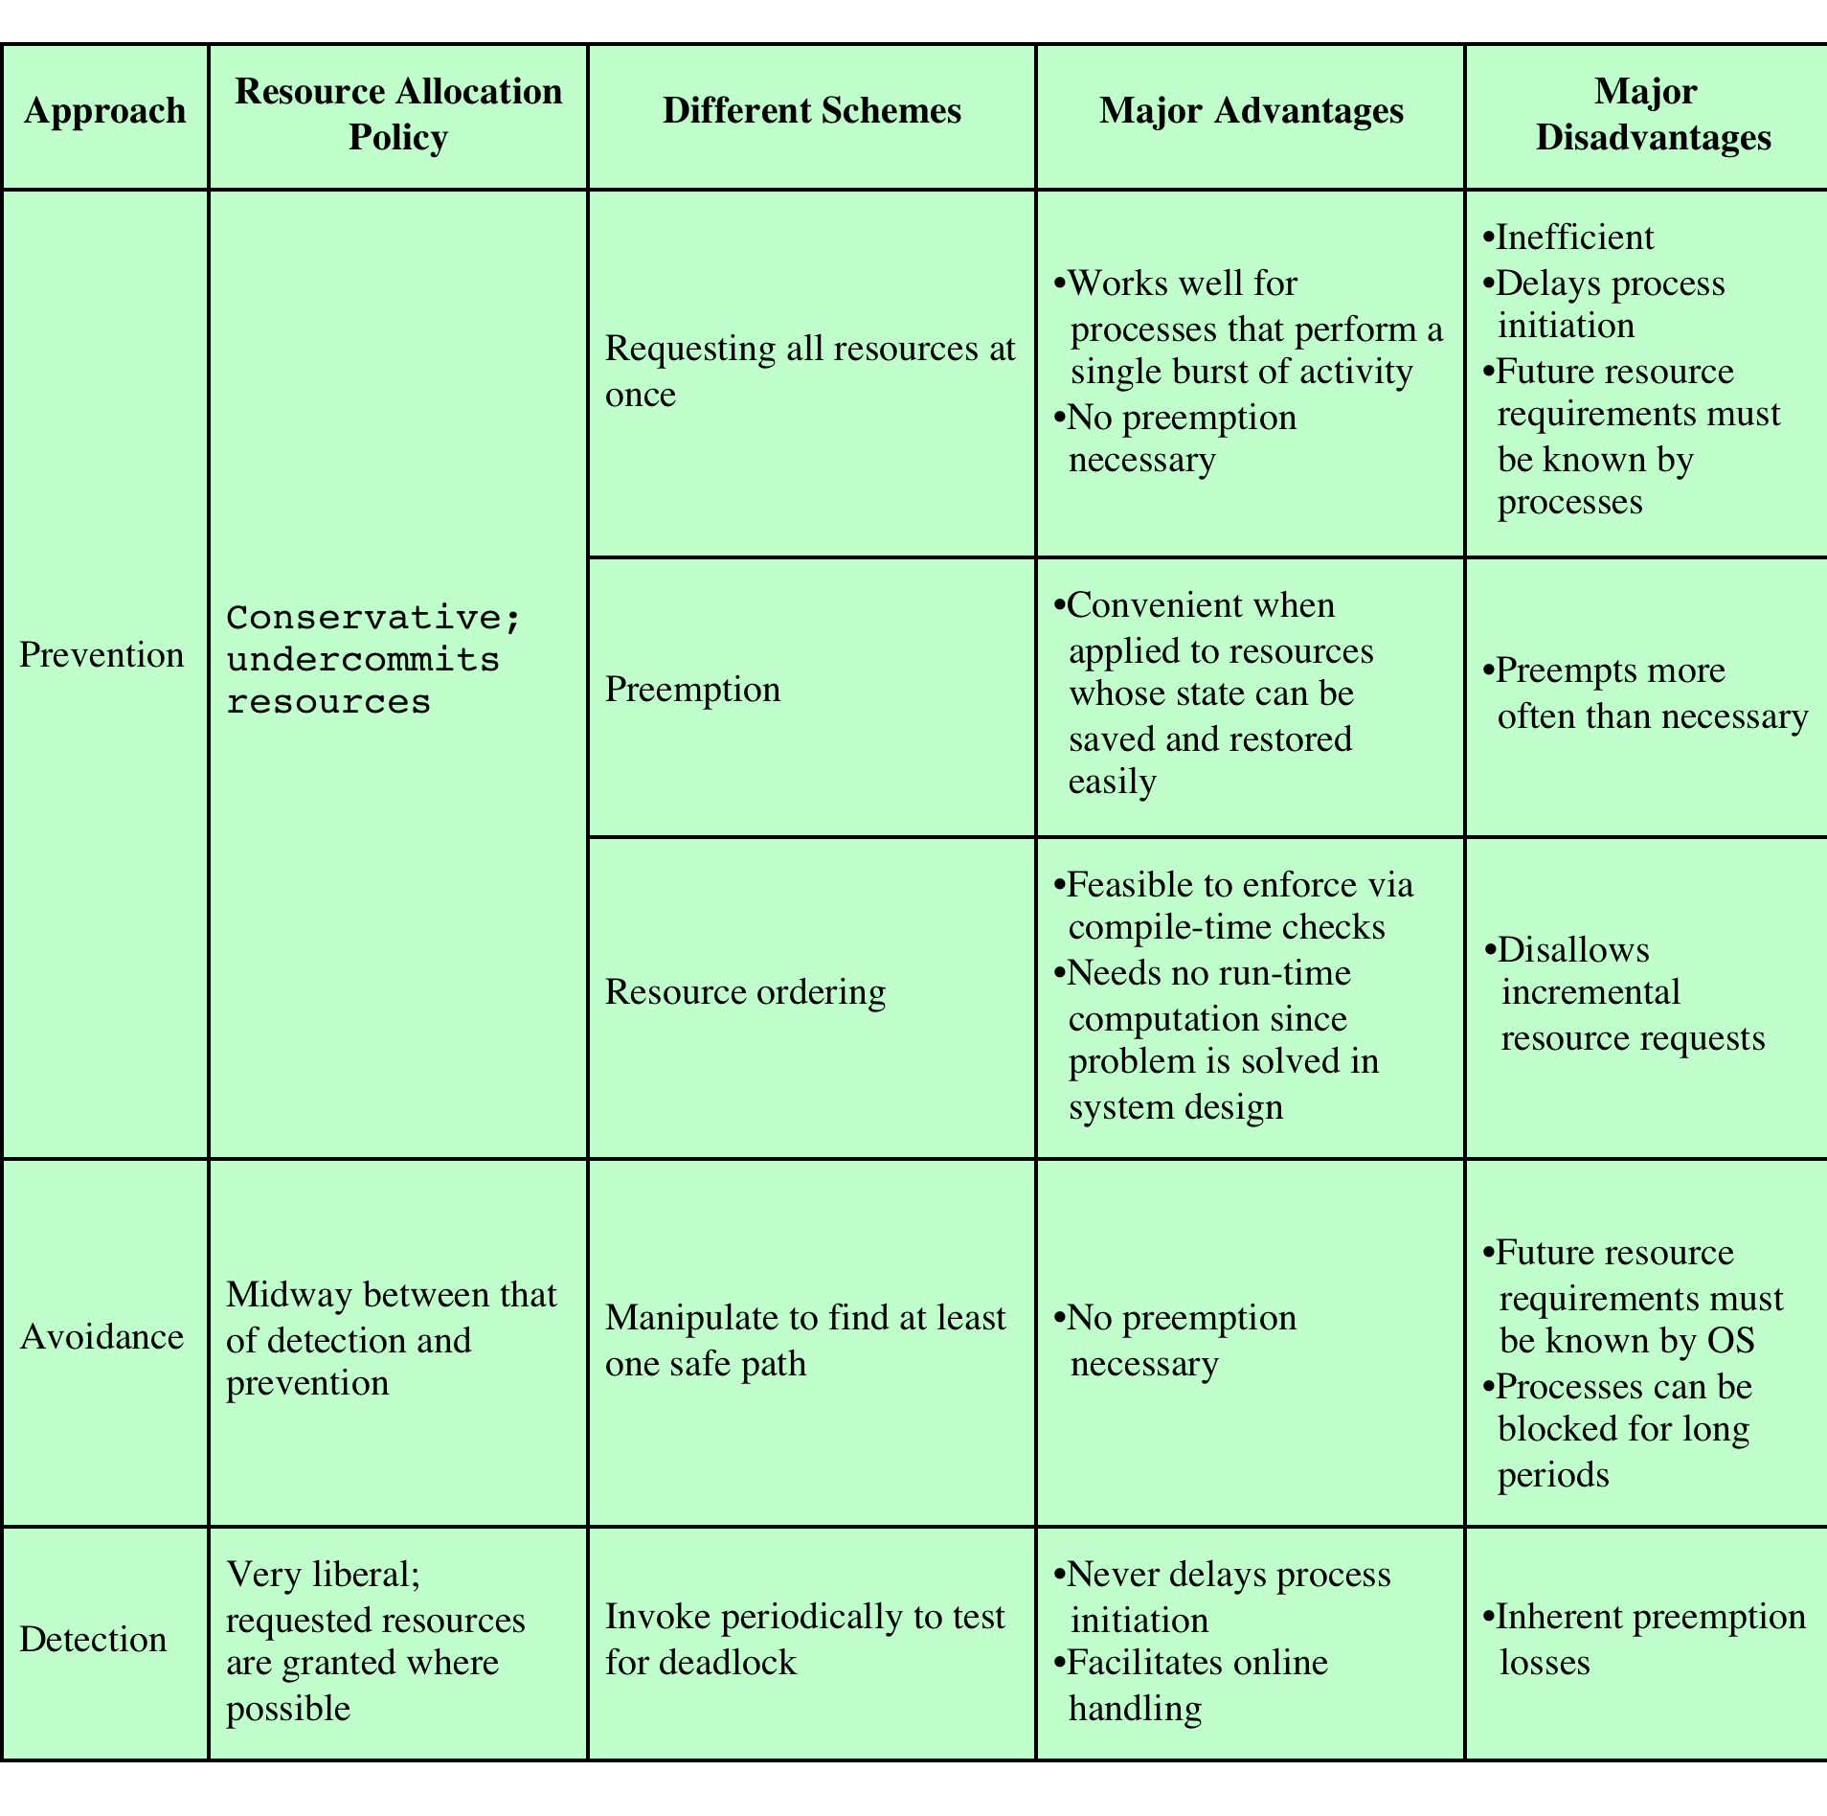
Deadlock Detection,
Prevention, and Avoidance
Notes:
There is no single effective strategy that can deal with all types of deadlock. Table 6.1 summarizes the key elements of the most important approaches that have been developed: prevention, avoidance, and detection. We examine each of these in turn, after first introducing resource allocation graphs and then discussing the conditions for deadlock.

Slide 11
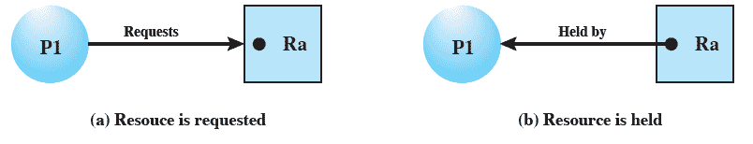
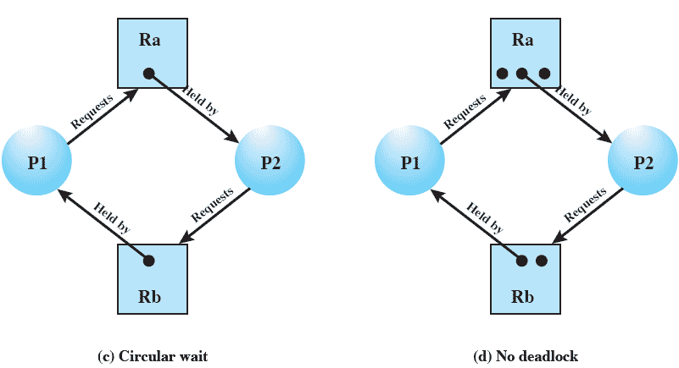
Resource Allocation Graphs
Notes:
A useful tool in characterizing the allocation of resources to processes is the resource allocation graph , introduced by Holt [HOLT72]. The resource allocation graph is a directed graph that depicts a state of the system of resources and processes, with each process and each resource represented by a node. A graph edge directed from a process to a resource indicates a resource that has been requested by the process but not yet granted ( Figure 6.5a ). Within a resource node, a dot is shown for each instance of that resource. Examples of resource types that may have multiple instances are I/O devices that are allocated by a resource management module in the OS. A graph edge directed from a reusable resource node dot to a process indicates a request that has been granted ( Figure 6.5b ); that is, the process has been assigned one unit of that resource. A graph edge directed from a consumable
resource node dot to a process indicates that the process is the producer of that
resource.
Figure 6.5c shows an example deadlock. There is only one unit each of resources Ra and Rb. Process P1 holds Rb and requests Ra, while P2 holds Ra but requests Rb. Figure 6.5d has the same topology as Figure 6.5c , but there is no deadlock because multiple units of each resource are available.

Slide 12
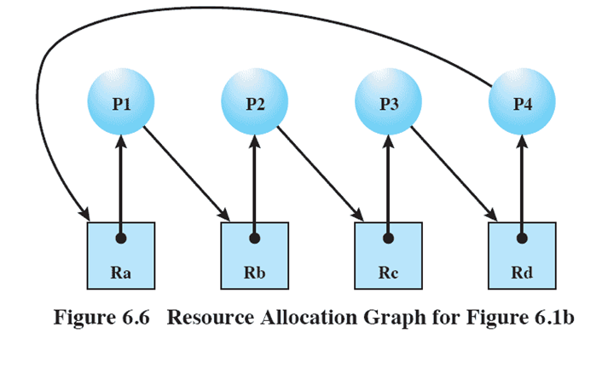
Resource Allocation Graphs
Notes:
The resource allocation graph of Figure 6.6 corresponds to the deadlock situation in Figure 6.1b . Note that in this case, we do not have a simple situation in which two processes each have one resource the other needs. Rather, in this case, there is a circular chain of processes and resources that results in deadlock.

Slide 13
Conditions for Deadlock
Mutual Exclusion
only one process may use a resource at a time
Hold-and-Wait
a process may hold allocated resources while awaiting assignment of others
No Pre-emption
no resource can be forcibly removed from a process holding it
Circular Wait
a closed chain of processes exists, such that each process holds at least one resource needed by the next process in the chain
Notes:
Three conditions of policy must be present for a deadlock to be possible:
1. Mutual exclusion . Only one process may use a resource at a time. No process may access a resource unit that has been allocated to another process.
2. Hold and wait . A process may hold allocated resources while awaiting assignment of other resources.
3. No preemption . No resource can be forcibly removed from a process holding it.
In many ways these conditions are quite desirable. For example, mutual exclusion is needed to ensure consistency of results and the integrity of a database. Similarly, preemption should not be done arbitrarily. For example, when data resources are involved, preemption must be supported by a rollback recovery mechanism, which restores a process and its resources to a suitable previous state from which the process can eventually repeat its actions.
The first three conditions are necessary but not sufficient for a deadlock to exist. For deadlock to actually take place, a fourth condition is required:
4. Circular wait . A closed chain of processes exists, such that each process holds at least one resource needed by the next process in the chain (e.g., Figure 6.5c
and Figure 6.6 ).
The fourth condition is, actually, a potential consequence of the first three. That is, given that the first three conditions exist, a sequence of events may occur that lead to an unresolvable circular wait. The unresolvable circular wait is in fact the definition of deadlock. The circular wait listed as condition 4 is unresolvable because the first three conditions hold. Thus, the four conditions, taken together, constitute necessary and sufficient conditions for deadlock.

Slide 14
Dealing with Deadlock
Three general approaches exist for dealing with deadlock:
Prevent Deadlock
adopt a policy that eliminates one of the conditions
Avoid Deadlock
make the appropriate dynamic choices based on the current state of resource allocation
Detect Deadlock
attempt to detect the presence of deadlock and take action to recover
Notes:
Three general approaches exist for dealing with deadlock. First, one can prevent deadlock by adopting a policy that eliminates one of the conditions (conditions 1 through 4). Second, one can avoid deadlock by making the appropriate dynamic choices based on the current state of resource allocation. Third, one can attempt to detect the presence of deadlock (conditions 1 through 4 hold) and take action to recover.

Slide 15
Deadlock Prevention Strategy
Design a system in such a way that the possibility of deadlock is excluded
Two main methods:
  Indirect
    prevent the occurrence of one of the three necessary conditions
  Direct
    prevent the occurrence of a circular wait
Notes:
The strategy of deadlock prevention is, simply put, to design a system in such a way that the possibility of deadlock is excluded. We can view deadlock prevention methods as falling into two classes. An indirect method of deadlock prevention is to prevent the occurrence of one of the three necessary conditions listed previously (items 1 through 3). A direct method of deadlock prevention is to prevent the occurrence of a circular wait (item 4).

Slide 16
Deadlock Condition
Prevention
Mutual Exclusion
if access to a resource requires mutual exclusion then it must be supported by the OS
Hold and Wait
require that a process request all of its required resources at one time and blocking the process until all requests can be granted simultaneously
Notes:
Mutual Exclusion
In general, the first of the four listed conditions cannot be disallowed. If access to a resource requires mutual exclusion, then mutual exclusion must be supported by the OS. Some resources, such as files, may allow multiple accesses for reads but only exclusive access for writes. Even in this case, deadlock can occur if more than one process requires write permission.
Hold and Wait
The hold-and-wait condition can be prevented by requiring that a process request all of its required resources at one time and blocking the process until all requests can be granted simultaneously. This approach is inefficient in two ways. First, a process may be held up for a long time waiting for all of its resource requests to be filled, when in fact it could have proceeded with only some of the resources. Second, resources allocated to a process may remain unused for a considerable period, during which time they are denied to other processes. Another problem is that a process may not know in advance all of the resources that it will require.
There is also the practical problem created by the use of modular programming or a multithreaded structure for an application. An application would need to be aware of all resources that will be requested at all levels or in all modules to make the simultaneous request.

Slide 17
Deadlock Condition
Prevention
No Preemption
  if a process holding certain resources is denied a further request, that process must release its original resources and request them again
  OS may preempt the second process and require it to release its resources
Circular Wait
  define a linear ordering of resource types
Notes:
No Preemption
This condition can be prevented in several ways. First, if a process holding certain resources is denied a further request, that process must release its original resources and, if necessary, request them again together with the additional resource. Alternatively, if a process requests a resource that is currently held by another process, the OS may preempt the second process and require it to release its resources. This latter scheme would prevent deadlock only if no two processes possessed the same priority.
This approach is practical only when applied to resources whose state can be easily saved and restored later, as is the case with a processor.
Circular Wait
The circular-wait condition can be prevented by defining a linear ordering of resource types. If a process has been allocated resources of type R , then it may subsequently request only those resources of types following R in the ordering. To see that this strategy works, let us associate an index with each resource type. Then resource R i precedes R j in the ordering if i < j . Now suppose that two processes, A and B, are deadlocked because A has acquired R i and requested R j , and B has acquired R j and requested R i . This condition is impossible because it implies i < j and j < i .
As with hold-and-wait prevention, circular-wait prevention may be inefficient, slowing down processes and denying resource access unnecessarily.

Slide 18

Deadlock Avoidance
A decision is made dynamically whether the current resource allocation request will, if granted, potentially lead to a deadlock
Requires knowledge of future process requests
Notes:
An approach to solving the deadlock problem that differs subtly from deadlock prevention is deadlock avoidance. 2 In deadlock prevention , we constrain resource requests to prevent at least one of the four conditions of deadlock. This is either done indirectly, by preventing one of the three necessary policy conditions (mutual exclusion, hold and wait, no preemption), or directly, by preventing circular wait. This leads to inefficient use of resources and inefficient execution of processes. Deadlock avoidance , on the other hand, allows the three necessary conditions but makes judicious choices to assure that the deadlock point is never reached. As such, avoidance allows more concurrency than prevention. With deadlock avoidance, a decision is made dynamically whether the current resource allocation request will, if granted, potentially lead to a deadlock. Deadlock avoidance thus requires knowledge
of future process resource requests.

Slide 19
Two Approaches to
Deadlock Avoidance
Deadlock Avoidance
Process Initiation Denial
Resource Allocation Denial
do not start a process if its demands might lead to deadlock
do not grant an incremental resource request to a process if this allocation might lead to deadlock
Notes:
In this section, we describe two approaches to deadlock avoidance:
• Do not start a process if its demands might lead to deadlock.
• Do not grant an incremental resource request to a process if this allocation might lead to deadlock.

Slide 20

Resource Allocation Denial
Referred to as the banker’s algorithm
State of the system reflects the current allocation of resources to processes
Safe state is one in which there is at least one sequence of resource allocations to processes that does not result in a deadlock
Unsafe state is a state that is not safe
Notes:
The strategy of resource allocation denial, referred to as the banker’s algorithm , was first proposed in [DIJK65]. Let us begin by defining the concepts of state and safe state. Consider a system with a fixed number of processes and a fixed number of resources. At any time a process may have zero or more resources allocated to it. The state of the system reflects the current allocation of resources to processes. Thus, the state consists of the two vectors, Resource and Available, and the two matrices, Claim and Allocation, defined earlier. A safe state is one in which there is at least one sequence of resource allocations to processes that does not result in a deadlock (i.e., all of the processes can be run to completion). An unsafe state is, of course, a state that is not safe.

Slide 21
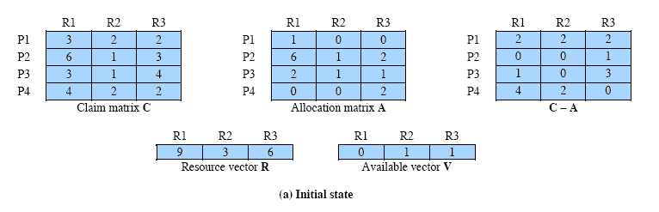
Determination of a Safe State
State of a system consisting of four processes and three resources
Allocations have been made to the four processes
Notes:
Animation: Callouts explain resource parts of figure
The following example illustrates these concepts. Figure 6.7a shows the state of a system consisting of four processes and three resources. The total amount of resources R1, R2, and R3 are 9, 3, and 6 units, respectively. In the current state allocations have been made to the four processes, leaving 1 unit of R2 and 1 unit of R3 available. Is this a safe state? To answer this question, we ask an intermediate question: Can any of the four processes be run to completion with the resources available? That is, can the difference between the maximum requirement and current allocation for any process be met with the available resources? In terms of the matrices and vectors introduced earlier, the condition to be met
for process i is:
Cij - Aij … Vj, for all j

Slide 22
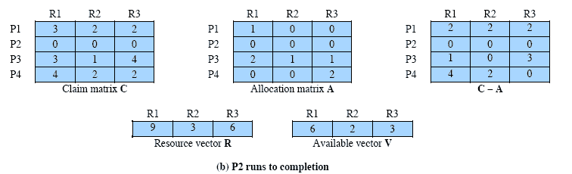
P2 Runs to Completion
Notes:
Clearly, this is not possible for P1, which has only 1 unit of R1 and requires 2 more units of R1, 2 units of R2, and 2 units of R3. However, by assigning one unit of R3 to process P2, P2 has its maximum required resources allocated and can run to completion. Let us assume that this is accomplished. When P2 completes, its resources can be returned to the pool of available resources. The resulting state is shown in Figure 6.7b . Now we can ask again if any of the remaining processes can be completed. In this case, each of the remaining processes could be completed.

Slide 23
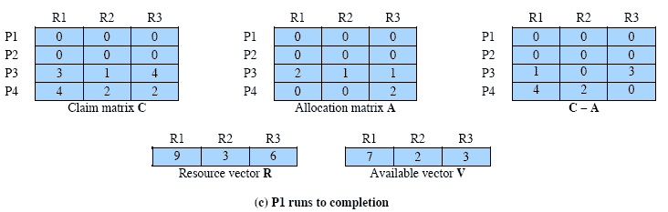
P1 Runs to Completion
Notes:
Suppose we choose P1, allocate the required resources, complete P1, and return all of P1’s resources to the available pool. We are left in the state shown in Figure 6.7c .

Slide 24
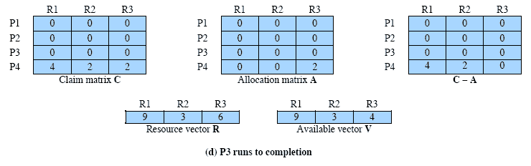
P3 Runs to Completion
Thus, the state defined originally is a safe state
Notes:
Next, we can complete P3, resulting in the state of Figure 6.7d . Finally, we can complete P4. At this point, all of the processes have been run to completion. Thus, the state defined by Figure 6.7a is a safe state.
These concepts suggest the following deadlock avoidance strategy, which ensures that the system of processes and resources is always in a safe state. When a process makes a request for a set of resources, assume that the request is granted, update the system state accordingly, and then determine if the result is a safe state. If so, grant the request and, if not, block the process until it is safe to grant the request.

Slide 25
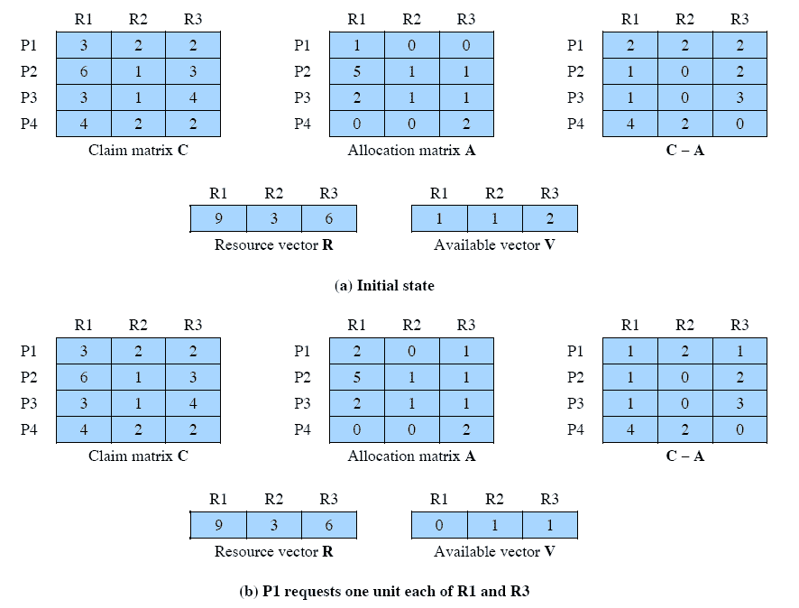
Determination of an
Unsafe State
Notes:
Consider the state defined in Figure 6.8a . Suppose P2 makes a request for one additional unit of R1 and one additional unit of R3. If we assume the request is granted, then the resulting state is that of Figure 6.7a . We have already seen that this is a safe state; therefore, it is safe to grant the request. Now let us return to the state of Figure 6.8a and suppose that P1 makes the request for one additional unit each of R1 and R3; if we assume that the request is granted, we are left in the state of Figure 6.8b . Is this a safe state? The answer is no, because each process will need at least one additional unit of R1, and there are none available. Thus, on the basis of deadlock avoidance, the request by P1 should be denied and P1 should be blocked.
It is important to point out that Figure 6.8b is not a deadlocked state. It merely has the potential for deadlock. It is possible, for example, that if P1 were run from this state it would subsequently release one unit of R1 and one unit of R3 prior to needing these resources again. If that happened, the system would return to a safe state. Thus, the deadlock avoidance strategy does not predict deadlock with certainty; it merely anticipates the possibility of deadlock and assures that there is never such a possibility.

Slide 26
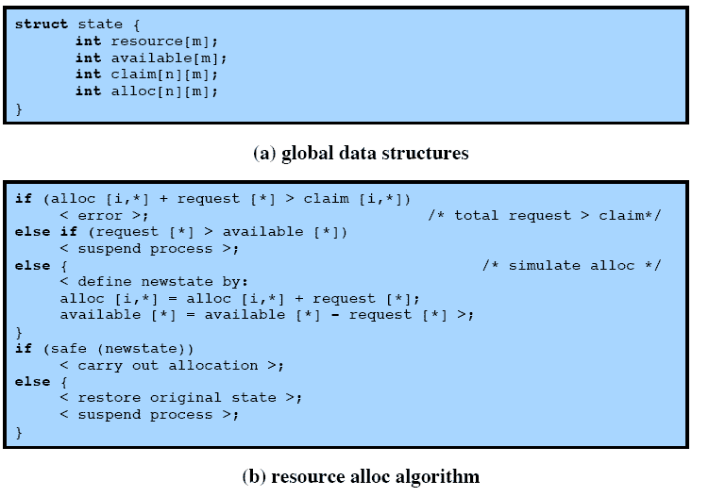
Deadlock Avoidance Logic
Notes:
Figure 6.9 gives an abstract version of the deadlock avoidance logic. The main algorithm is shown in part (b). With the state of the system defined by the data structure state , request[*] is a vector defining the resources requested by process i . First, a check is made to assure that the request does not exceed the original claim of the process. If the request is valid, the next step is to determine if it is possible to fulfill the request (i.e., there are sufficient resources available). If it is not possible, then the process is suspended. If it is possible, the final step is to
determine if it is safe to fulfill the request. To do this, the resources are tentatively assigned to process i to form newstate .

Slide 27
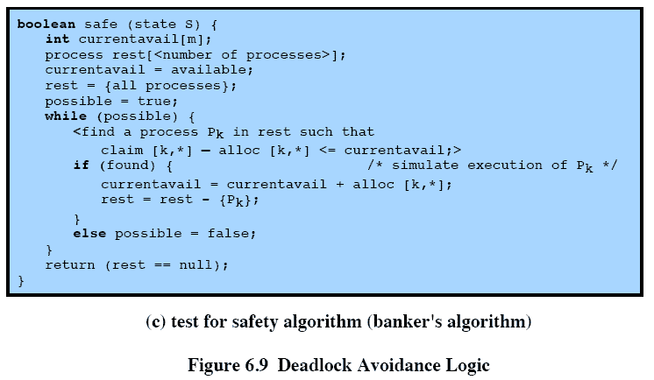
Deadlock Avoidance Logic
Notes:
Then a test for safety is made using the algorithm in Figure 6.9c.

Slide 28
Deadlock Avoidance Advantages
It is not necessary to preempt and rollback processes, as in deadlock detection
It is less restrictive than deadlock prevention
Notes:
Deadlock avoidance has the advantage that it is not necessary to preempt and
rollback processes, as in deadlock detection, and is less restrictive than deadlock
prevention.

Slide 29
Deadlock Avoidance Restrictions
Maximum resource requirement for each process must be stated in advance
Processes under consideration must be independent and with no synchronization requirements
There must be a fixed number of resources to allocate
No process may exit while holding resources
Notes:
However, it does have a number of restrictions on its use:
• The maximum resource requirement for each process must be stated in advance.
• The processes under consideration must be independent;
that is, the order in which they execute must be unconstrained by any synchronization requirements.
• There must be a fixed number of resources to allocate.
• No process may exit while holding resources.

Slide 30
Deadlock Strategies
Deadlock prevention strategies are very conservative
limit access to resources by imposing restrictions on processes
Deadlock detection strategies do the opposite
resource requests are granted whenever possible
Notes:
Deadlock prevention strategies are very conservative; they solve the problem of deadlock by limiting access to resources and by imposing restrictions on processes. At the opposite extreme, deadlock detection strategies do not limit resource access or restrict process actions. With deadlock detection, requested resources are granted to processes whenever possible. Periodically, the OS performs an algorithm that allows it to detect the circular wait condition described earlier in condition (4) and illustrated in Figure 6.6 .

Slide 31
Deadlock Detection Algorithms
A check for deadlock can be made as frequently as each resource request or, less frequently, depending on how likely it is for a deadlock to occur
Advantages:
    it leads to early detection
    the algorithm is relatively simple
    Disadvantage
    frequent checks consume considerable processor time
Notes:
A check for deadlock can be made as frequently as each resource request or, less frequently, depending on how likely it is for a deadlock to occur. Checking at each resource request has two advantages: It leads to early detection, and the algorithm is relatively simple because it is based on incremental changes to the state of the system. On the other hand, such frequent checks consume considerable processor time.

Slide 32
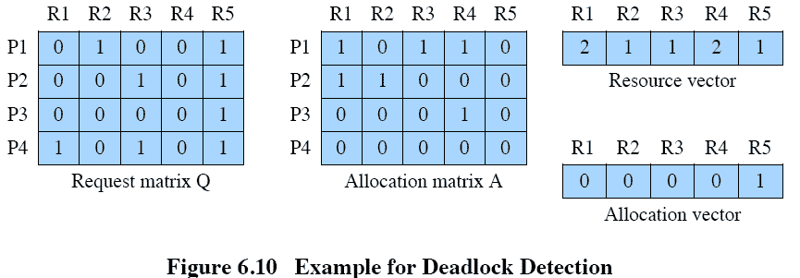
Deadlock Detection Algorithms
Notes:
We can use Figure 6.10 to illustrate the deadlock detection algorithm. The
algorithm proceeds as follows:
1. Mark P4, because P4 has no allocated resources.
2. Set W = (0 0 0 0 1).
3. The request of process P3 is less than or equal to W, so mark P3 and set W=W + (0 0 0 1 0) = (0 0 0 1 1).
4. No other unmarked process has a row in Q that is less than or equal to W.
Therefore, terminate the algorithm.
The algorithm concludes with P1 and P2 unmarked, indicating that these processes are deadlocked.

Slide 33
Recovery Strategies
Abort all deadlocked processes
Back up each deadlocked process to some previously defined checkpoint and restart all processes
Successively abort deadlocked processes until deadlock no longer exists
Successively preempt resources until deadlock no longer exists
Notes:
Once deadlock has been detected, some strategy is needed for recovery. The following are possible approaches, listed in order of increasing sophistication:
1. Abort all deadlocked processes. This is, believe it or not, one of the most common, if not the most common, solution adopted in operating systems.
2. Back up each deadlocked process to some previously defined checkpoint, and restart all processes. This requires that rollback and restart mechanisms be built
in to the system. The risk in this approach is that the original deadlock may recur. However, the nondeterminancy of concurrent processing may ensure that this does not happen.
3. Successively abort deadlocked processes until deadlock no longer exists. The order in which processes are selected for abortion should be on the basis of some criterion of minimum cost. After each abortion, the detection algorithm must be reinvoked to see whether deadlock still exists.
4. Successively preempt resources until deadlock no longer exists. As in (3), a costbased selection should be used, and reinvocation of the detection algorithm is required after each preemption. A process that has a resource preempted from it must be rolled back to a point prior to its acquisition of that resource.
For (3) and (4), the selection criteria could be one of the following. Choose the process with the
• least amount of processor time consumed so far
• least amount of output produced so far
• most estimated time remaining
least total resources allocated so far
• lowest priority
Some of these quantities are easier to measure than others. Estimated time remaining is particularly suspect. Also, other than by means of the priority measure, there is no indication of the “cost” to the user, as opposed to the cost to the system as a whole.

Slide 34
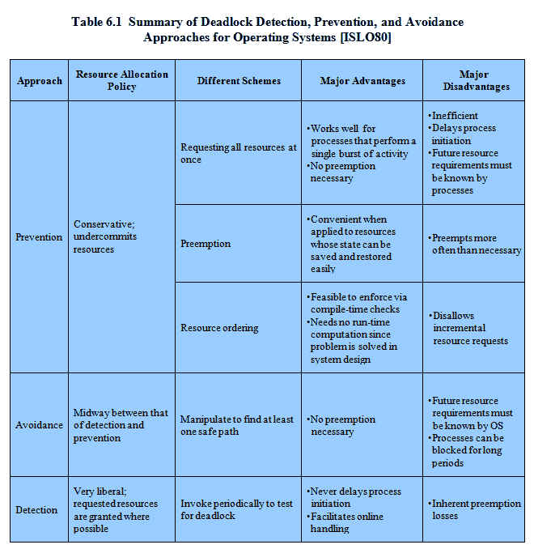
Deadlock Approaches
Notes:
As Table 6.1 suggests, there are strengths and weaknesses to all of the strategies for dealing with deadlock. Rather than attempting to design an OS facility that employs only one of these strategies, it might be more efficient to use different strategies in different situations.

Slide 35
Integrated Deadlock
Strategy
Rather than attempting to design an OS facility that employs only one of these strategies, it might be more efficient to use different strategies in different situations
    Group resources into a number of different resource classes
    Use the linear ordering strategy defined previously for the prevention of circular wait to prevent deadlocks between resource classes
    Within a resource class, use the algorithm that is most appropriate for that class
    Classes of resources
    Swappable space
        Blocks of memory on secondary storage for use in swapping processes
    Process resources
        Assignable devices, such as tape drives, and files
    Main memory
        Assignable to processes in pages or segments
    Internal resources
        Such as I/O channels
Notes:
There are strengths and weaknesses to all of the strategies for dealing with deadlock.
Rather than attempting to design an OS facility that employs only one of these
strategies, it might be more efficient to use different strategies in different situations.
[HOWA73] suggests one approach:
• Group resources into a number of different resource classes.
• Use the linear ordering strategy defined previously for the prevention of circular
wait to prevent deadlocks between resource classes.
• Within a resource class, use the algorithm that is most appropriate for that class.
As an example of this technique, consider the following classes of resources:
• Swappable space: Blocks of memory on secondary storage for use in swapping
processes
• Process resources: Assignable devices, such as tape drives, and files
• Main memory: Assignable to processes in pages or segments
• Internal resources: Such as I/O channels

Slide 36
Class Strategies
Within each class the following strategies could be used:
  Swappable space
      Prevention of deadlocks by requiring that all of the required resources that may be used be allocated at one time, as in the hold-and-wait prevention strategy
      This strategy is reasonable if the maximum storage requirements are known
  Process resources
      Avoidance will often be effective in this category, because it is reasonable to expect processes to declare ahead of time the resources that they will require in this class
      Prevention by means of resource ordering within this class is also possible
  Main memory
      Prevention by preemption appears to be the most appropriate strategy for main memory
      When a process is preempted, it is simply swapped to secondary memory, freeing space to resolve the deadlock
  Internal resources
      Prevention by means of resource ordering can be used
Notes:
The order of the preceding list represents the order in which resources are
assigned. The order is a reasonable one, considering the sequence of steps that a
process may follow during its lifetime. Within each class, the following strategies
could be used:
• Swappable space: Prevention of deadlocks by requiring that all of the required
resources that may be used be allocated at one time, as in the hold-and-wait
prevention strategy. This strategy is reasonable if the maximum storage
requirements are known, which is often the case. Deadlock avoidance is also
a possibility.
• Process resources: Avoidance will often be effective in this category, because
it is reasonable to expect processes to declare ahead of time the resources that
they will require in this class. Prevention by means of resource ordering within
this class is also possible.
• Main memory: Prevention by preemption appears to be the most appropriate
strategy for main memory. When a process is preempted, it is simply swapped
to secondary memory, freeing space to resolve the deadlock.
• Internal resources: Prevention by means of resource ordering can be used.

Slide 37
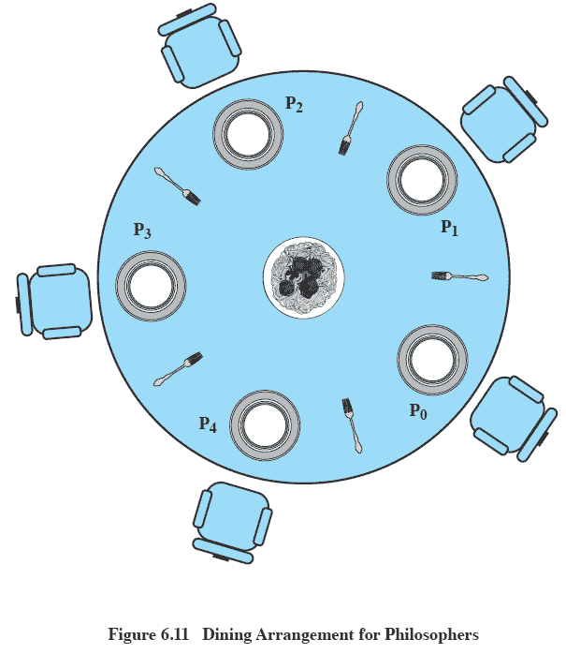
Dining Philosophers Problem
  No two philosophers can use the same fork at the same time (mutual exclusion)
  No philosopher must starve to death (avoid deadlock and starvation)
Notes:
We now turn to the dining philosophers problem, introduced by Dijkstra [DIJK71]. Five philosophers live in a house, where a table is laid for them. The life of each philosopher consists principally of thinking and eating, and through years of thought, all of the philosophers had agreed that the only food that contributed to their thinking efforts was spaghetti. Due to a lack of manual skill, each philosopher requires two forks to eat spaghetti.
The eating arrangements are simple ( Figure 6.11 ): a round table on which is set a large serving bowl of spaghetti, five plates, one for each philosopher, and five forks. A philosopher wishing to eat goes to his or her assigned place at the table and, using the two forks on either side of the plate, takes and eats some spaghetti. The problem: Devise a ritual (algorithm) that will allow the philosophers to eat. The algorithm must satisfy mutual exclusion (no two philosophers can use the same fork at the same time) while avoiding deadlock and starvation (in this case, the term has literal as well as algorithmic meaning!).
This problem may not seem important or relevant in itself. However, it does illustrate basic problems in deadlock and starvation. Furthermore, attempts to develop solutions reveal many of the difficulties in concurrent programming (e.g., see [GING90]). In addition, the dining philosophers problem can be seen as representative of problems dealing with the coordination of shared resources, which may occur when an application includes concurrent threads of execution. Accordingly, this problem is a standard test case for evaluating approaches to synchronization.
Possible solutions are on the following slides.

Slide 38
Figure 6.12 A First Solution to the Dining Philosophers Problem
Notes:
Figure 6.12 suggests a solution using semaphores. Each philosopher picks up first the fork on the left and then the fork on the right. After the philosopher is finished eating, the two forks are replaced on the table. This solution, alas, leads to deadlock: If all of the philosophers are hungry at the same time, they all sit down, they all pick up the fork on their left, and they all reach out for the other fork, which is not there. In this undignified position, all philosophers starve.
To overcome the risk of deadlock, we could buy five additional forks (a more sanitary solution!) or teach the philosophers to eat spaghetti with just one fork. As another approach, we could consider adding an attendant who only allows four philosophers at a time into the dining room. With at most four seated philosophers, at least one philosopher will have access to two forks.

Slide 39
Figure 6.13 A Second Solution to the Dining Philosophers Problem
Notes:
Figure 6.13 shows such a solution, again using semaphores. This solution is free of deadlock and starvation.

Slide 40
Summary
Deadlock:
  the blocking of a set of processes that either compete for system resources or communicate with each other
  blockage is permanent unless OS takes action
  may involve reusable or consumable resources
    Consumable = destroyed when acquired by a process
    Reusable = not depleted/destroyed by use
Dealing with deadlock:
  prevention – guarantees that deadlock will not occur
  detection – OS checks for deadlock and takes action
  avoidance – analyzes each new resource request
Notes:
Chapter 6 summary.

